Slide 1
Adventure Works
Data Analytics

Slide 2
Problem Statement
Adventure Works Cycles, a global bicycle manufacturing company, aims to expand its market share while reducing operational costs. Despite a successful fiscal year, the company lacks clear visibility into:
High-value customers and their purchasing behavior
Top-performing products and revenue contributors
Regional sales performance across global markets
Cost inefficiencies in production and distribution

Slide 3
Data Sources
Adventure Works Excel dataset
Fact and Dimension tables
Sales, Customers, Products, Geography

Slide 4
Data Modeling
Star schema design
Fact table: Sales
Dimension tables: Customer, Product, Region, Date
Established relationships for analysis

Slide 5
Tools Used
Excel – data cleaning & preprocessing
Power BI – dashboard & visualization
Tableau – interactive analysis
SQL – data extraction, joins, and transformation for analysis

Slide 6
Key Dashboards
Sales performance overview
Region-wise sales analysis
Top products & categories
Customer segmentation

Slide 7
Insights
Identified top-performing regions
High revenue from specific product categories
Seasonal sales trends observed
Key customer segments driving revenue

Slide 8
Dashboard Implementation
EXCEL
Cleaned raw data (handled missing values, formatting issues)
Created structured datasets for analysis
Performed initial data validation
POWER BI
Built interactive dashboards with KPIs (Sales, Profit, Orders)
Created DAX measures (Total Sales, Profit %, Growth)
Designed filters and drill-down features

Slide 9
Dashboard Implementation
TABLEAU
Developed visual dashboards for trend analysis
Created region-wise and product-wise insights
Used interactive filters for business exploration
SQL
Wrote queries using JOIN, GROUP BY, WHERE
Extracted and transformed data from multiple tables
Prepared analysis-ready datasets

Slide 10
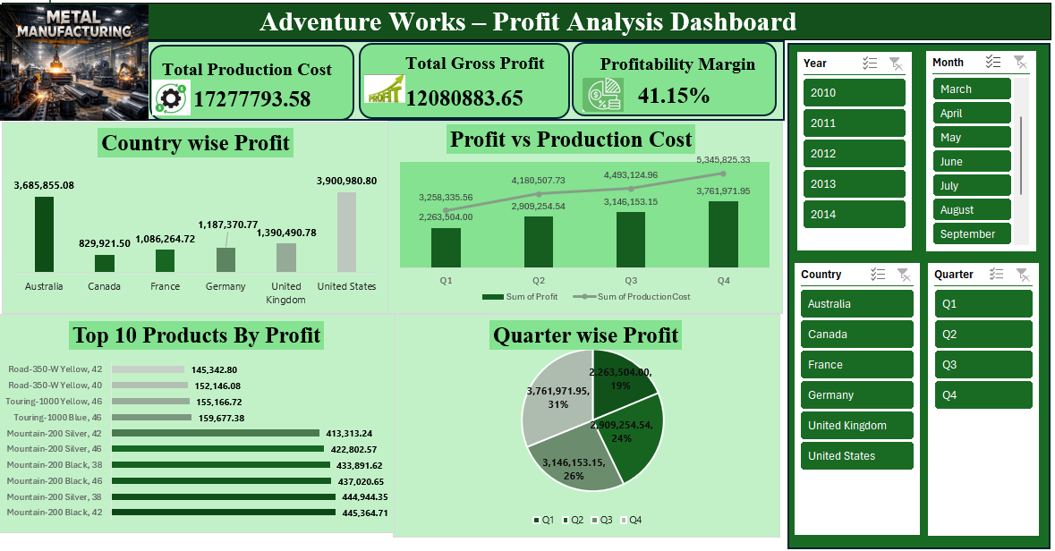
EXCEL Dashboard

Slide 11
Dashboard Development Process
Data Collection
Imported data into Excel from source files
Data Cleaning
Removed duplicates, handled missing values, formatted data
Data Preparation
Organized data into structured tables for analysis
Data Linking
Used relationships via common fields (or combined using sheets)

Slide 12
Dashboard Development Process
Calculations
Created formulas Total Sales, Total Cost, Profit, Profit Margin % Some extra usefull columns also.
Visualization Design
Built KPI cards, bar charts, line charts, and slicers for analysis
Insights & Analysis
Identified trends, top-performing periods, and profitability

Slide 13
Dashboard Overview
KPIs Summary
Displays Total Sales, Production Cost, Profit, and Profit Margin
Regional Analysis
Compares profit across countries
Identifies top and underperforming regions
Product Performance
Highlights top products contributing to revenue

Slide 14
Dashboard Overview
Trend Analysis
Shows profit vs cost over time
Identifies growth patterns
Data Analysis (Pivot-Based)
Uses Pivot Tables and Charts for summarized insights
Key Insights
Few products generate majority revenue
Some regions outperform others

Slide 15
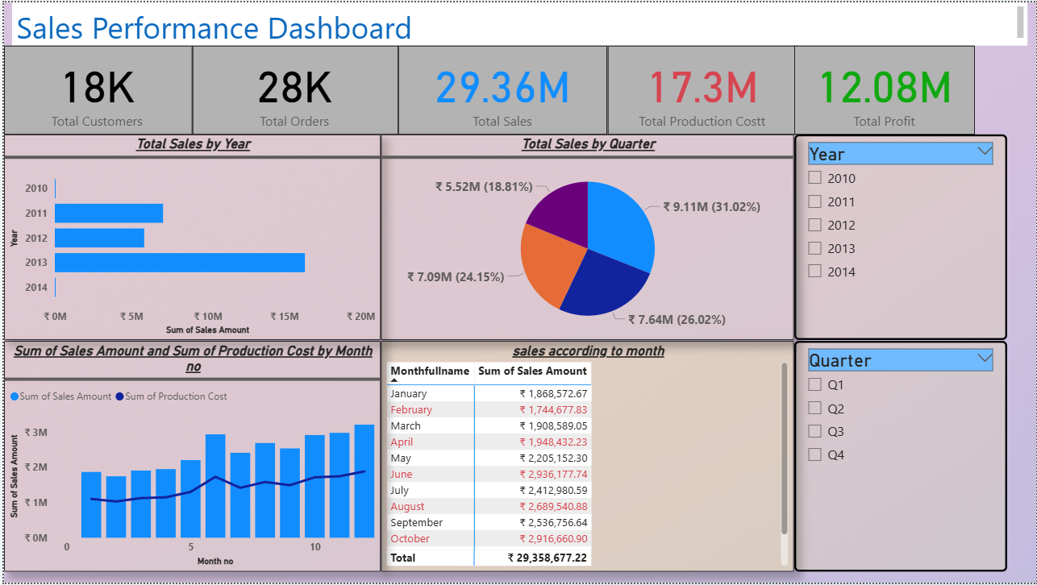
Power bi Dashboard

Slide 16
Dashboard Development Process
Data Loading
Imported data from Excel into Power BI
Data Cleaning
Handled missing values and corrected data types using Power Query
Data Modeling
Designed Star Schema with fact and dimension tables
Table Relationships
Created one-to-many relationships between tables

Slide 17
Dashboard Development Process
DAX Calculations
Created measures: Total Sales, Total Cost, Profit, Profit Margin
Visualization Design
Built KPI cards, charts, and slicers for analysis
Insights & Analysis
Identified key trends, top products, and profitable regions

Slide 18
Dashboard Overview
KPIs Summary
Total Customers, Orders, Sales, Cost, and Profit
Year & Quarter Analysis
Sales distribution across years and quarters
Identifies top-performing periods and seasonality
Monthly Trends
Compares Sales vs Production Cost
Tracks growth and cost variations

Slide 19
Dashboard Overview
Productivity Insights
Monthly sales breakdown for detailed analysis
Filters
Year and Quarter selection for analysis
Key Insights
Sales show steady growth over time
Certain months contribute higher revenue
Profit remains strong compared to cost

Slide 20
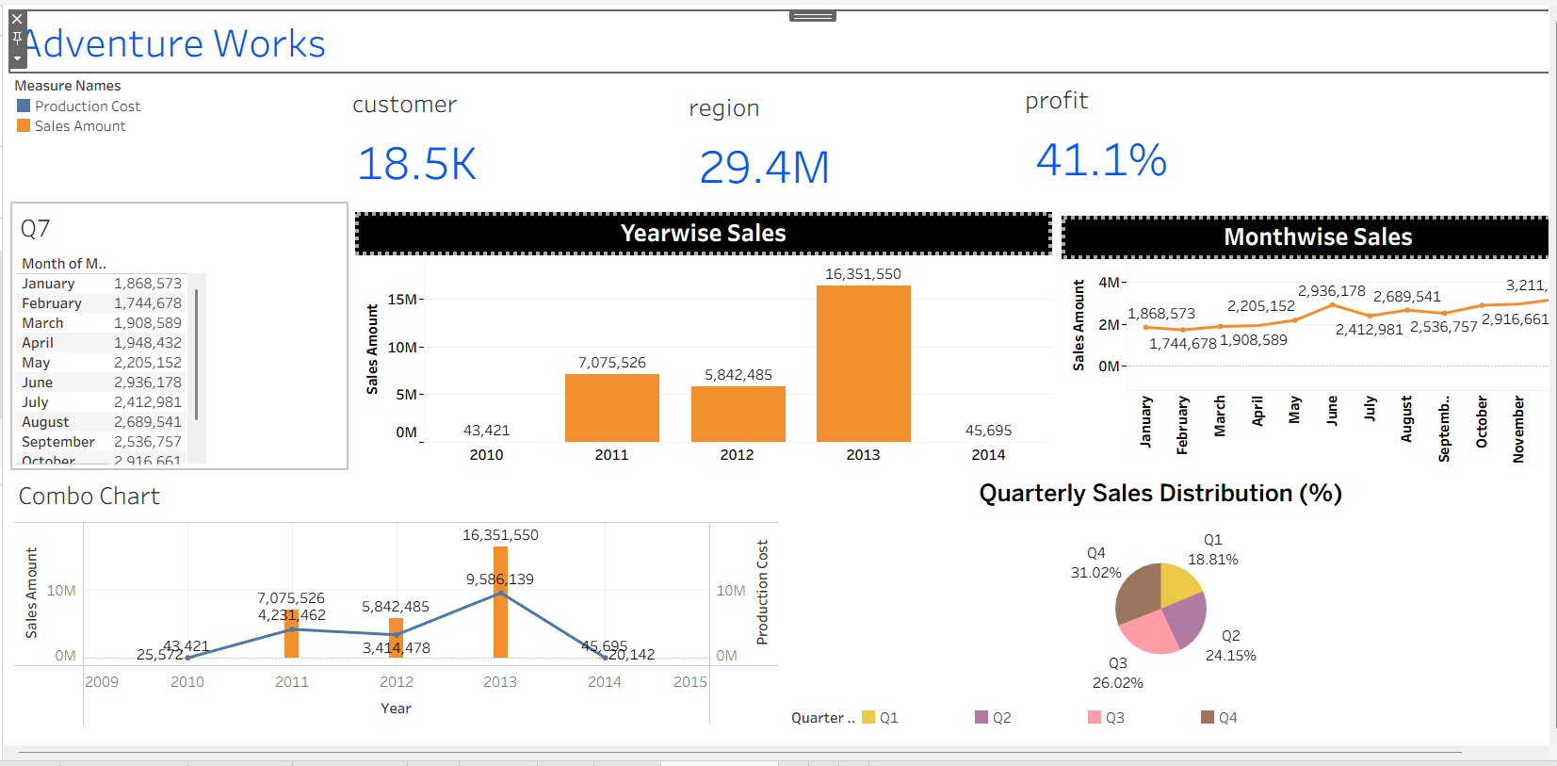
tableau Dashboard

Slide 21
Dashboard Development Process
Data Connection
Connected data from Excel/CSV into Tableau
Data Cleaning
Handled missing values and corrected data types
Data Modeling
Combined tables using joins/relationships
Table Relationships
Linked Sales with Product, Customer, and Date tables

Slide 22
Dashboard Development Process
Calculations
Created calculated fields: Sales, Cost, Profit, Profit Ratio
Visualization Design
Built charts (bar, line, pie) and applied filters
Insights & Analysis
Identified trends, top periods, and profitability

Slide 23
Dashboard Overview
KPIs Summary
Customers, Sales, Profit Margin
Year-wise Analysis
Sales distribution across years
Monthly Trends
Sales variation across months
Sales vs Cost Analysis
Compares Sales and Production Cost

Slide 24
Dashboard Overview
Quarter-wise Distribution
Contribution of each quarter
Data Breakdown
Month-wise detailed sales
Key Insights
Peak sales in specific periods
Seasonal trends observed
Profit remains stable

Slide 25
Data Processing & Analysis (SQL)
Data Integration
Combined datasets using UNION ALL to create a unified SALES table
Ensured complete data consolidation for analysis
Date Transformations
Extracted Year, Month, Quarter, Weekday using date functions
Created Financial Month & Financial Quarter using CASE statements
Calculated Columns
Created SalesAmount using:(unitprice*quantity)-discount
Added Production Cost and Profit columns

Slide 26
Data Processing & Analysis (SQL)
Table Enhancements
Used ALTER TABLE to add new calculated fields
Updated values using SQL update queries
Aggregations & Grouping
Applied GROUP BY to analyze:
Year-wise sales
Month-wise sales
Quarter-wise performance

Slide 27
Data Processing & Analysis (SQL)
Derived Tables
Created month_sales table for summarized monthly analysis
Stored aggregated results for reporting
Analysis Queries
Compared Sales vs Production Cost
Identified trends using aggregated datasets

Slide 28
Conclusion
Based on the Adventure Works business scenario, this project focused on improving sales performance and reducing operational costs through data analysis. Data was processed and structured using SQL, followed by analysis and visualization using Excel, Power BI, and Tableau. The dashboards provided insights into customer behavior, product performance, regional trends, and profitability. These insights help the business make informed decisions to increase market share, optimize costs, and target high-value customers effectively.

